Slide 1
Predicting Compressive strength of concrete
Team Name: V5
TEAM MEMBERS:
Abhiramrao Samudrala
Kasam Sai Shivani
Salla saketh
Battula sai samyuktha
Ambati akshaya

Slide 2
INDEX
1. Overview
2. Objective
3. Procedure
4. Multi variable Analysis
5. Machine learning Model
6. Accuracy
7. Demo

Slide 3
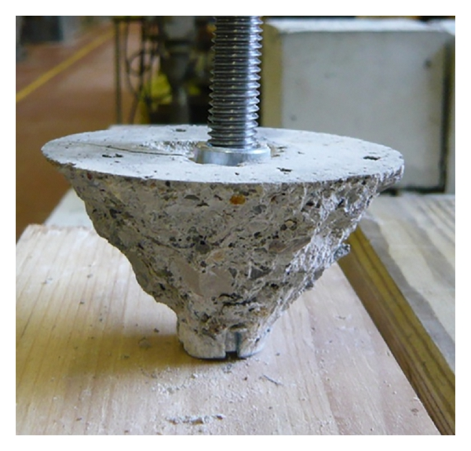
Overview :
The Compressive Strength of Concrete determines the quality of Concrete. This is generally determined by a standard crushing test on a concrete cylinder. This requires engineers to build small concrete cylinders with different combinations of raw materials and test these cylinders for strength variations with a change in each raw material. The recommended wait time for testing the cylinder is 28 days to ensure correct results. This consumes a lot of time and requires a lot of labor to prepare different prototypes and test them. Also, this method is prone to human error and one small mistake can cause the wait time to drastically increases.

Slide 4
Objective:
To measure the compressive strength of concrete , normally takes around 28 days of time period . Which causes the lack of work and most are not interested in continuing to do it.
So our idea is to build a machine learning model , which considers the some features and to measure the compressive strength of concrete without waiting for a larger amount of time.

Slide 5
Procedure:
Initially we are going to collect data from various sources and preprocess the data present in the dataset.
After preprocessing is over we are going to check the dependency of the features and sperate them as dependent and independent features.
Then we are going consider various Regression Algorithms and train them with the data. Then we calculate the accuracy and mean square error.

Slide 6
The Algorithm which is having More accuracy score and low mean square error is taken as the final Machine learning model
Then we build the User Interface i.e.; the flask application , where the user interacts with the web page and fill the feature values.
The inputs are given to the ML model and the respective predictive strength of concrete is given as Output to the user

Slide 7
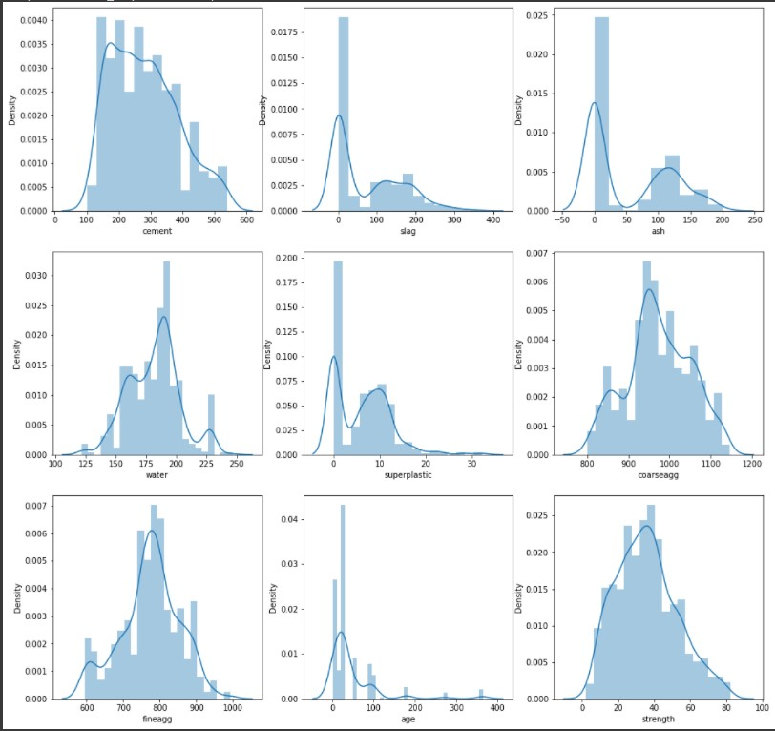
Multi Variable analysis:

Slide 8
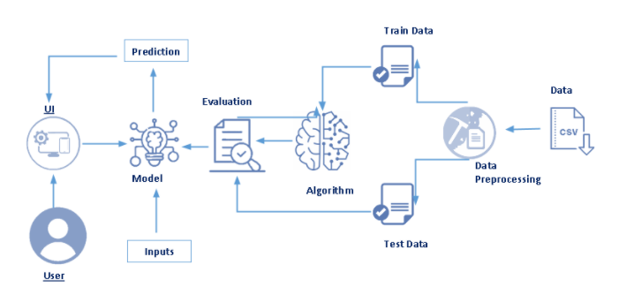
Model Flow :

Slide 9
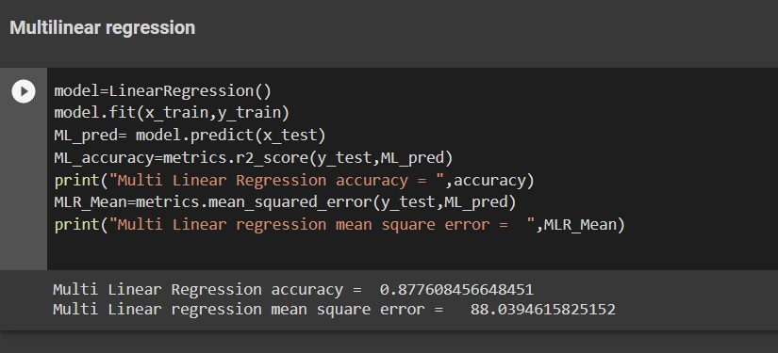
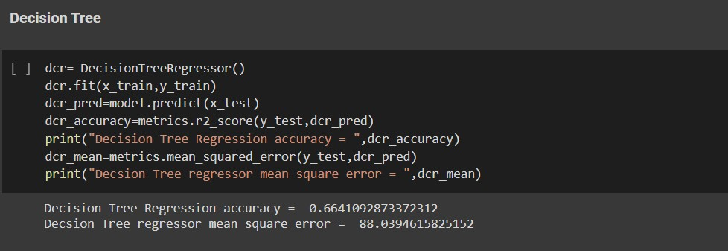
Accuracy :
Multi Linear Regression:
Decision Tree Regressor:

Slide 10
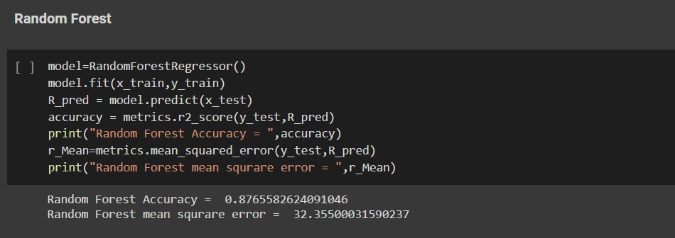
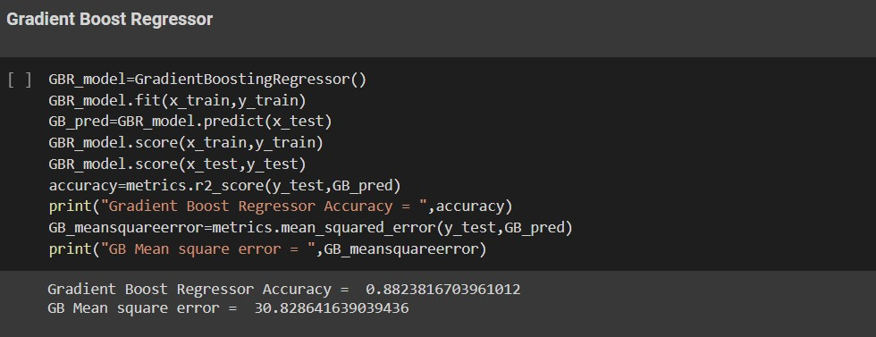
Random Forest Regressor :
Gradient Boost Regressor:
Since Gradient Boost Regressor is preforming good and having less mean square error , so we are going to use it as our machine learning model.

Slide 11
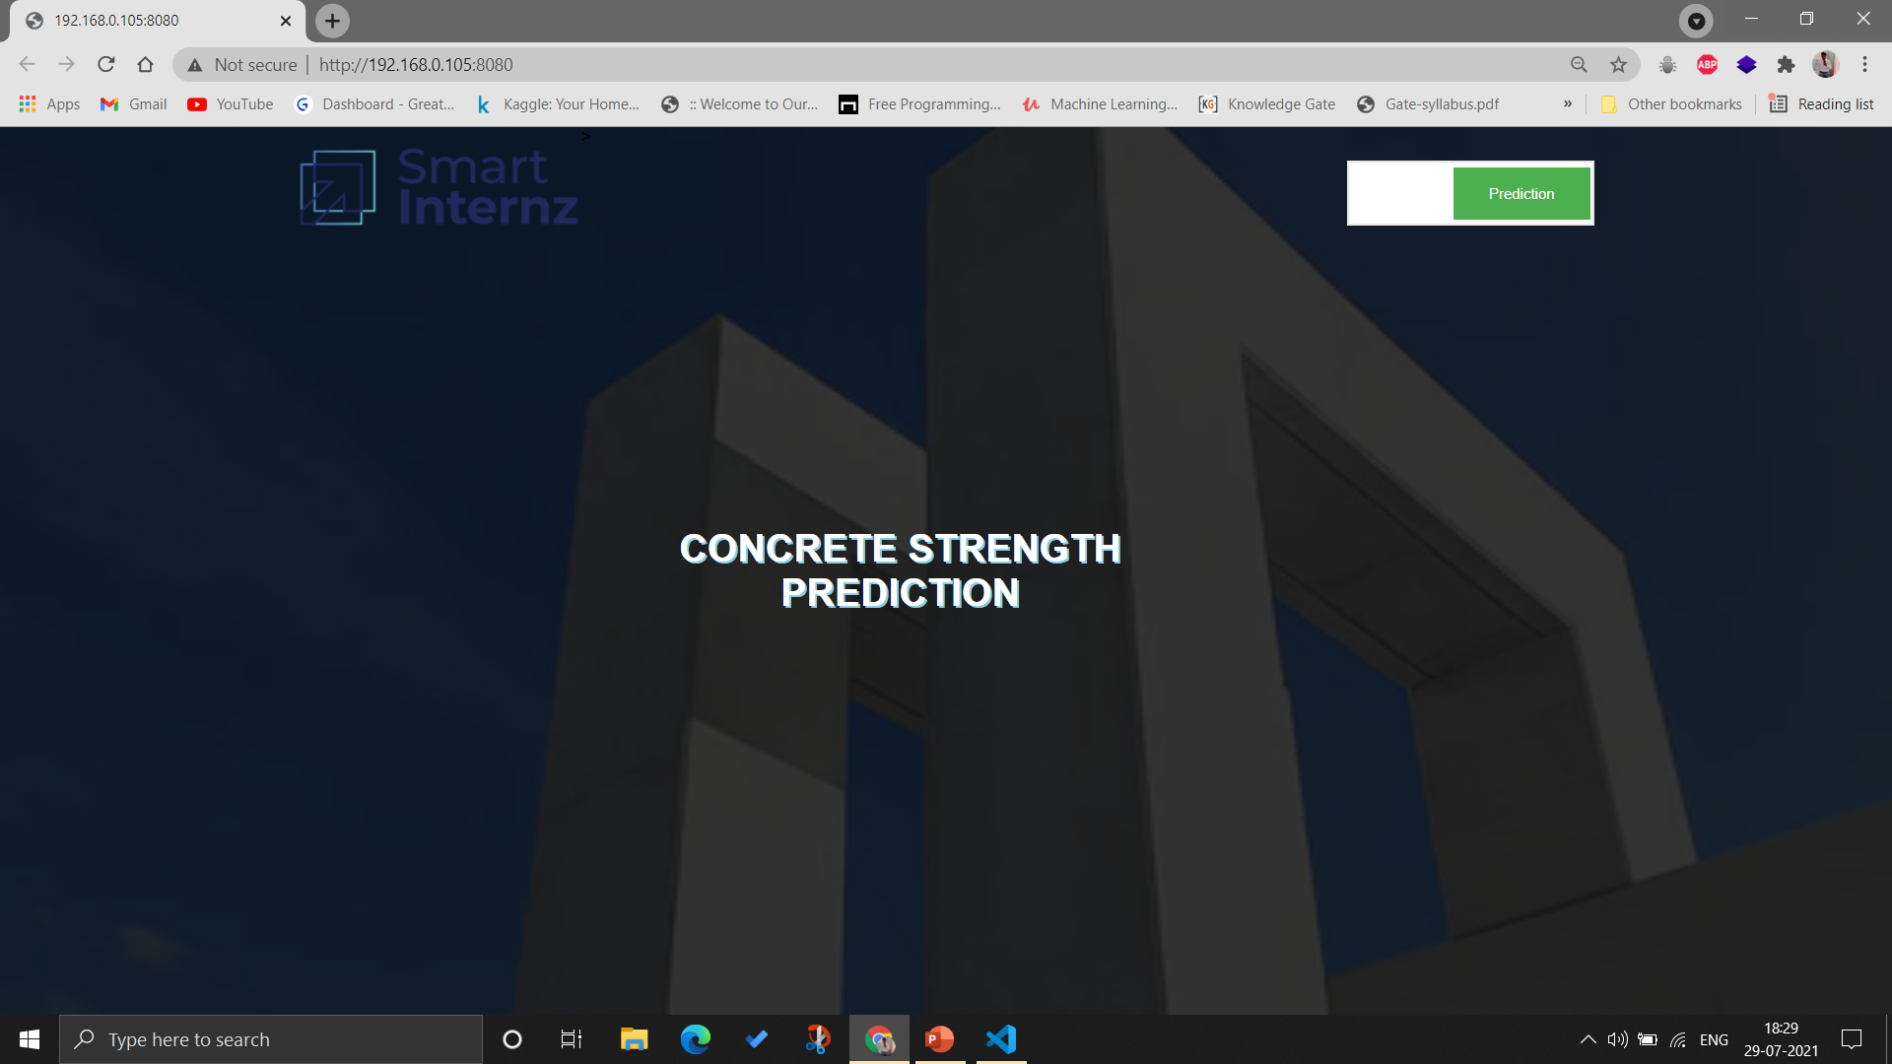
User Interface:

Slide 12
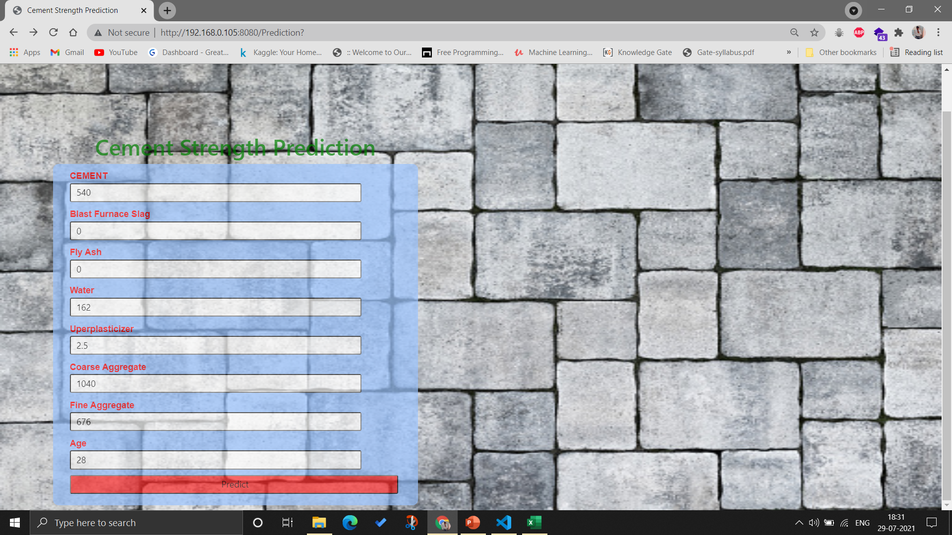

Slide 13
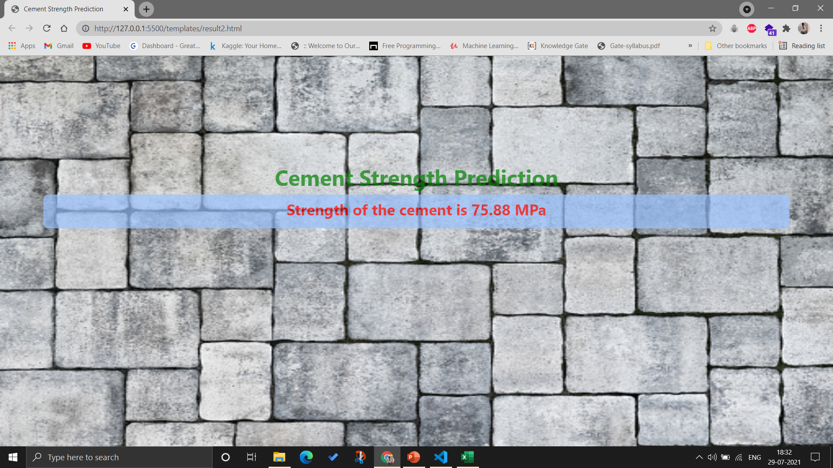

Slide 14
Thank You

